Slide 1

ImageNet Classification with CNN
HAN GAO
Concordia University

Slide 2
Project Base on:
Alex Krizhevsky, Ilya Sutskever and Geoffrey E. Hinton (2012). ImageNet Classification with Deep Convolutional Neural Networks, Advances in Neural Information Processing Systems 25, NIPS Proceedings, pp. 1097–1105.

Slide 3
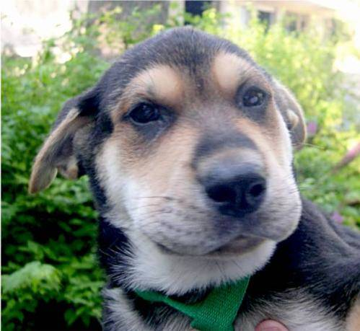
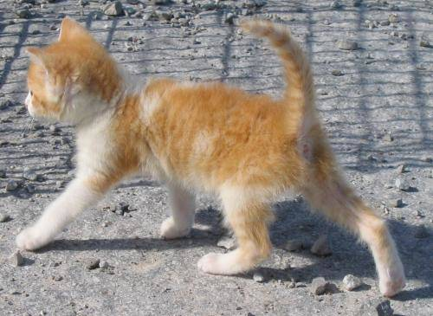
Objective : Classifying Cat and Dog by Convolutional Neural Networks
vs

Slide 4
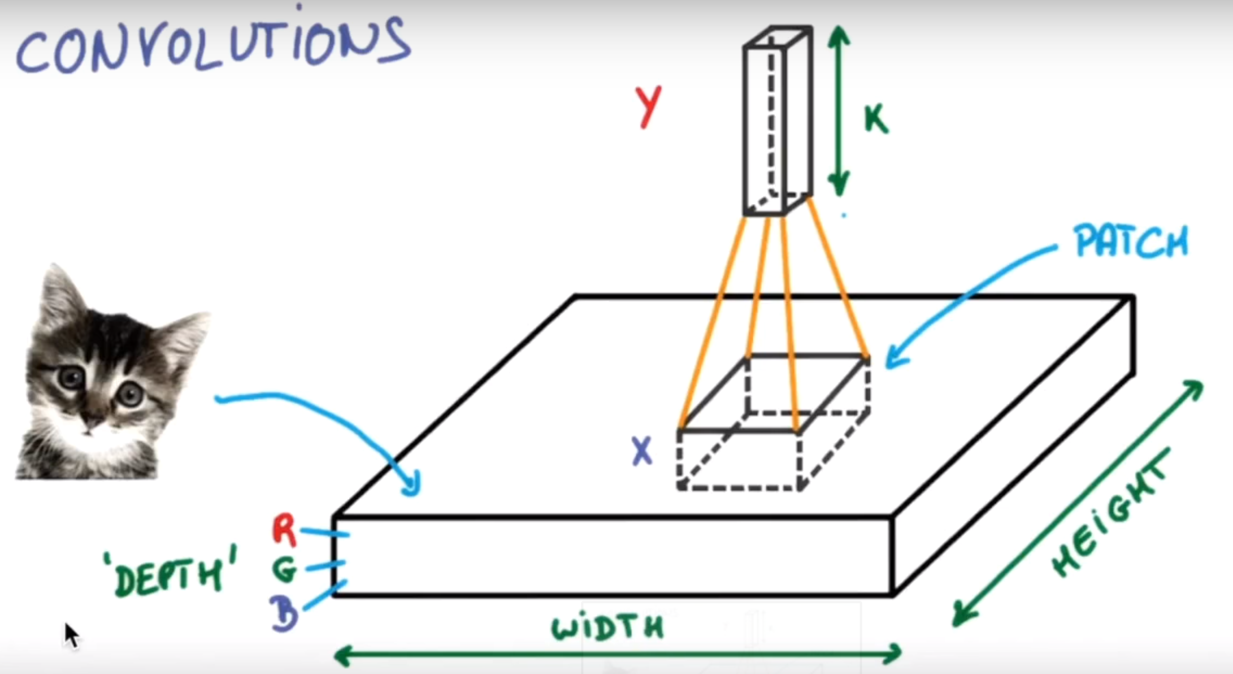
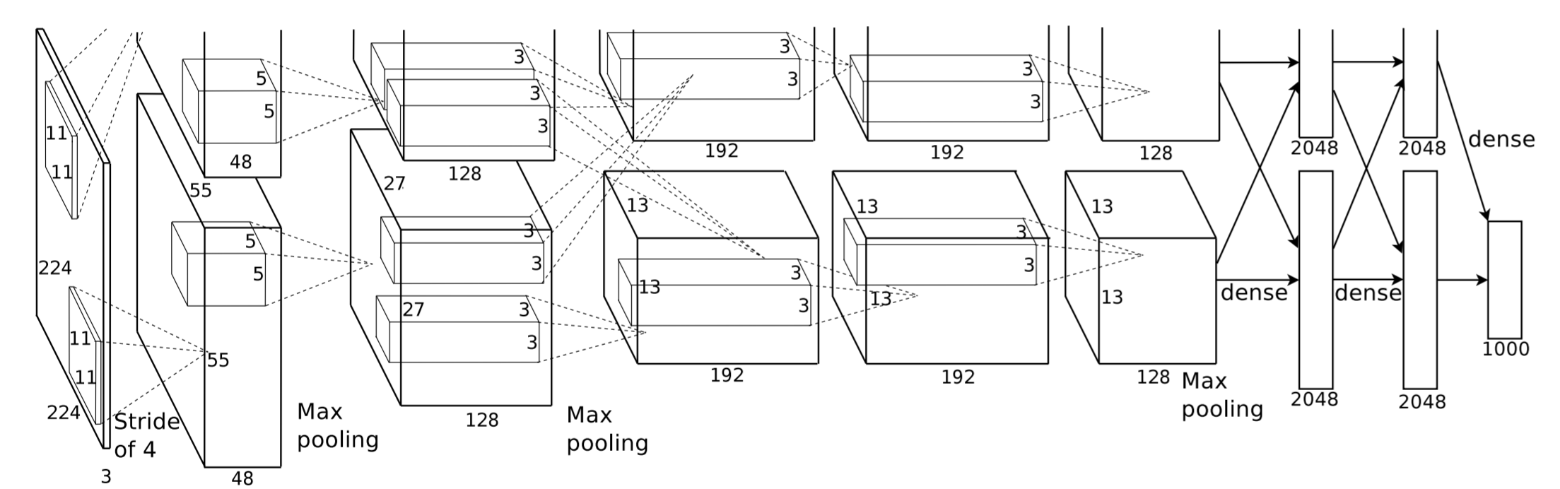
Convolutional Neural Networks
Convolutional Neural Networks(CNN) is a class of deep, feed-forward artificial neural networks, most commonly applied to analyzing visual imagery.
CNNs use a variation of multilayer perceptrons designed to require minimal preprocessing.

Slide 5
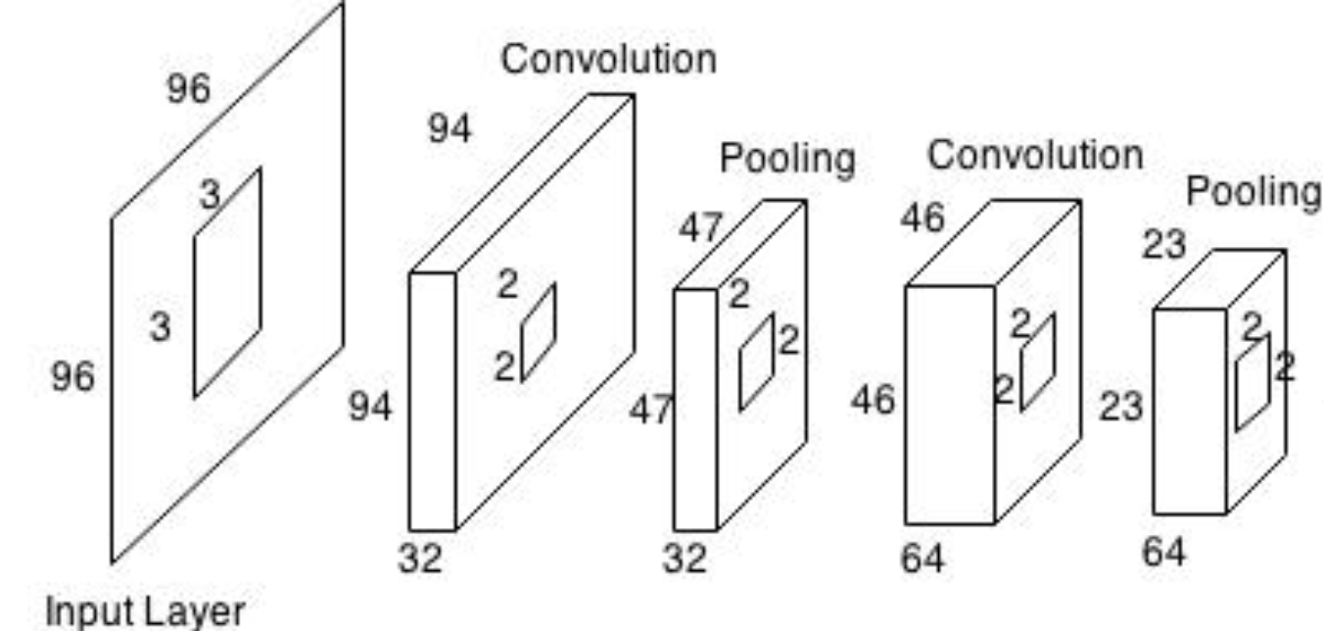
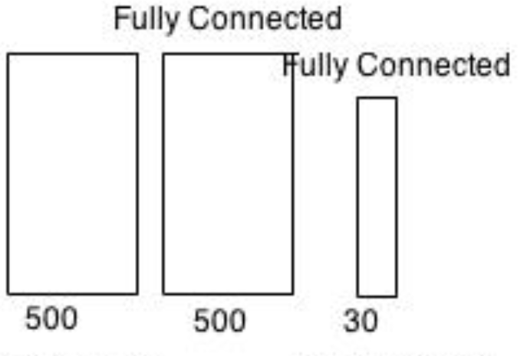
The Architecture
1. Processing training dataset (transfer images to tensor), save labels and image information
2. Building Convolutional Neural Networks
The networks consisted of a two-level cascaded CNN ( two sets of each convolution layer followed by a max-pooling layer ) followed by two fully connected hidden layers and the final output layer.
3. Training the model and testing.

Slide 6
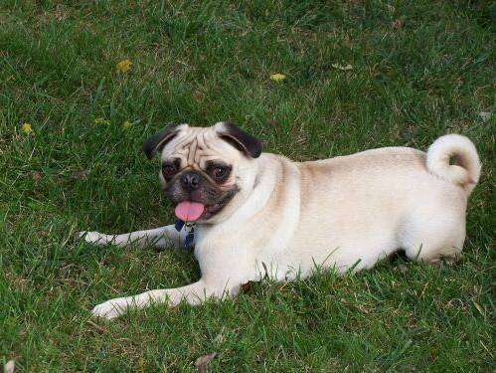
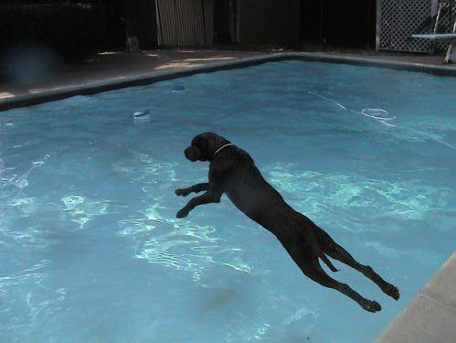
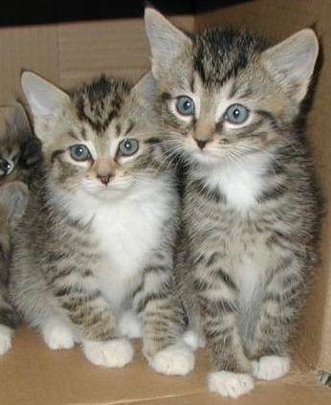
Results
Training dataset 25000 images and Testing dataset 5000 images
Cost 6 hours to training by using gradient decent(max steps 10000)
Training accuracy is avg 91% and Testing accuracy avg 88.6%
Dog with possibility 0.913
Dog with possibility 0.589
Cat with possibility 0.999

Slide 7
Thank you!!

